Slide 1
Electrical Circuit Analogy of
Stirling Type Pulse Tube Cryocooler (STPC)
ME 420 - Cryogenic Engineering 1
Seminar

Slide 2
Introduction
Among the many types of cryocoolers, the Stirling type Pulse tube Cryocooler(STPC) has advantages of compact structure, low vibration and high reliability.
So, it has been a topic of interest for many researchers to analyze and optimize its cooling performance.
Electrical Circuit Analogy (ECA) is a novel method of analyzing cryogenic systems using electrical circuits theory.

Slide 3
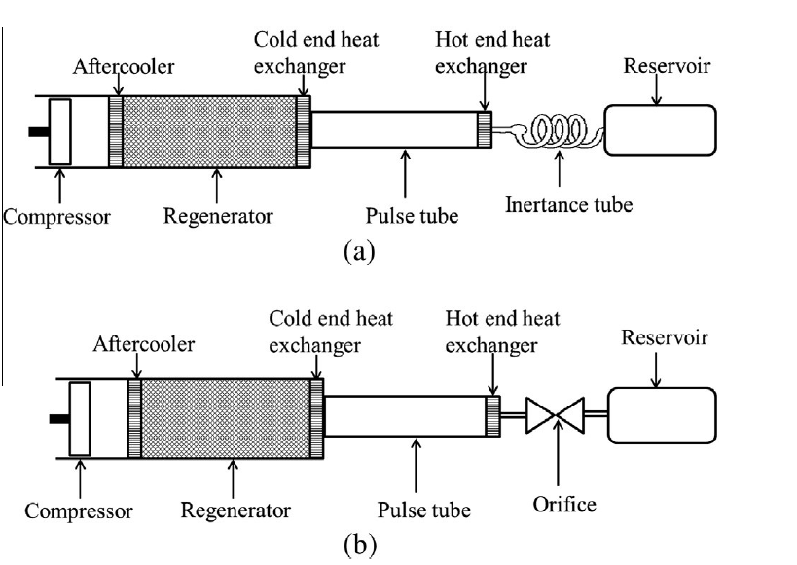
Stirling Type Pulse Tube CryoCooler
a)Inertance tube SPTC
b)Orifice SPTC

Slide 4
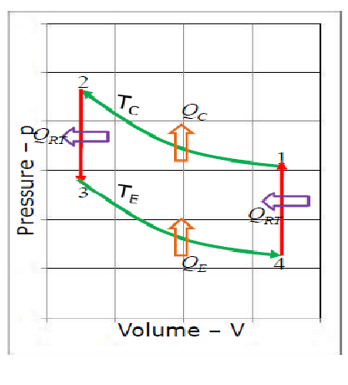
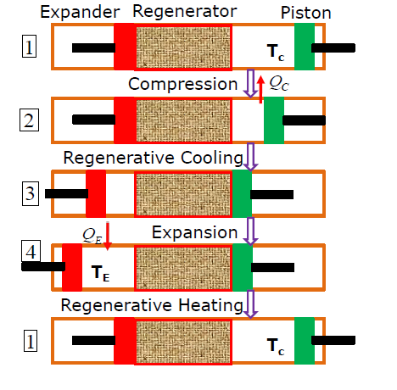
Stirling cycle
Courtesy: Prof.M Atrey’s slides

Slide 5
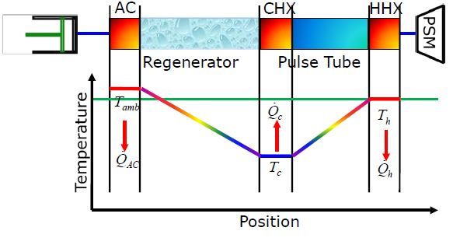
Temperature variation along stpc (in steady state)
Courtesy: Prof.M Atrey’s slides

Slide 6
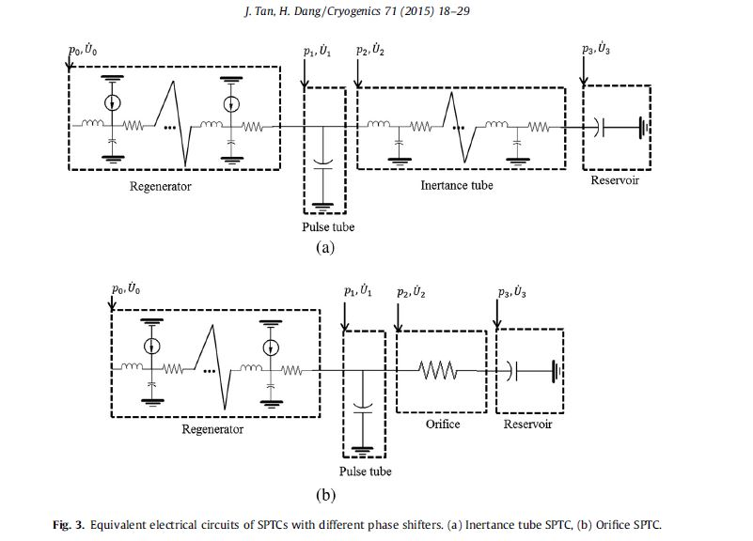
Actual Analogy used in this Paper
P_{x}
Pressure, P= P_{m}+Asin(wt)
Mean Volume flow rate = Zero!
Notes:
Px = variation in pressure

Slide 7
Acoustic Power
Product of first order variables (such as P1 and U1) represent power, This is of central importance in thermoacoustic engines and refrigerator.
Variation of parameters pressure and volume flow rate is in both time & space.
Acoustic Intensity, Ė₂(x) = 1/2*|p₁||U₁| cos(ɸ_{pU})
Here,
p₁= Variation from mean p_{m}
U₁= Flow rate
ɸ_{pU}= phase difference
Notes:
Product of two first order quantities gives second order quantity.

Slide 8

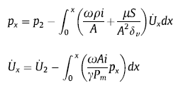




Equations used for Modelling
1) Regenerator
3a) Inertance Tube
2) Pulse Tube
3b) Orifice Tube
4) Reservoir
Note :
In Pulse Tube and Reservoir, the pressure is constant.
In Orifice Tube, volume flow rate is constant

Slide 9

Equations used for Modelling
R_{Fr} is resistance per unit length for mass flow rate.[4]
To get r_{g}, (resistance per unit length) for volume flow rate we multiply R_{Fr} with density.
In the controlled source term (in regenerator), g can be approximated as[6]
g = (1/T_{m})(dT_{m}/dx)

Slide 10
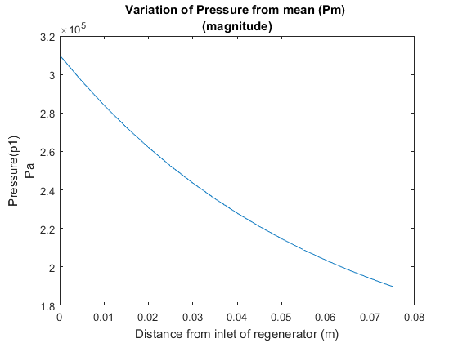
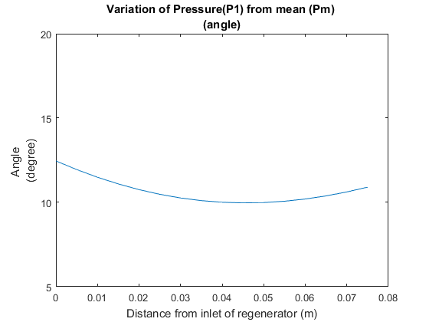
Regenerator plots (pressure)

Slide 11
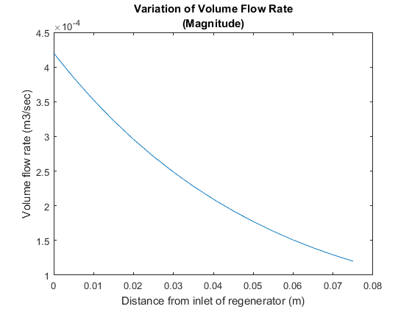
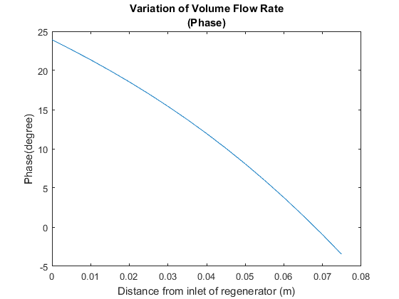
Regenerator plots (flow rate)

Slide 12
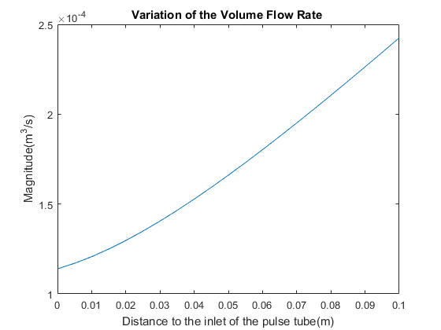
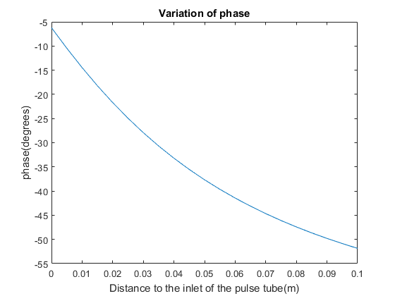
PULSE TUBE PLOTS (in inertance tube PTC)
Notes:
Adiabatic, Px = constant

Slide 13
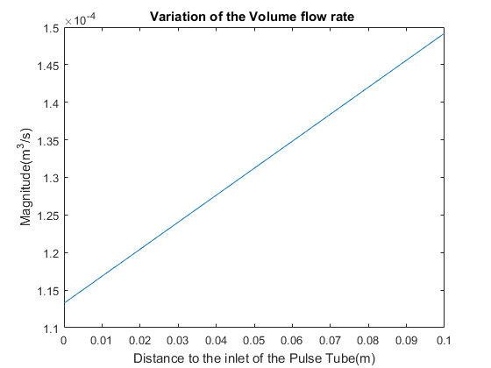
PULSE TUBE PLOTS(from the paper)
Look at the difference

Slide 14
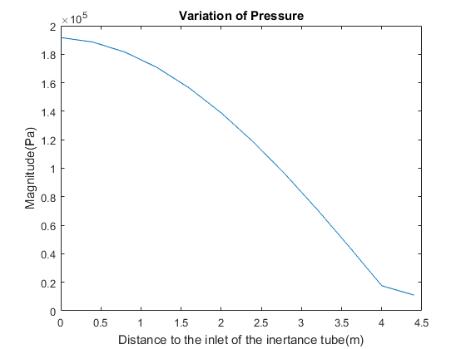
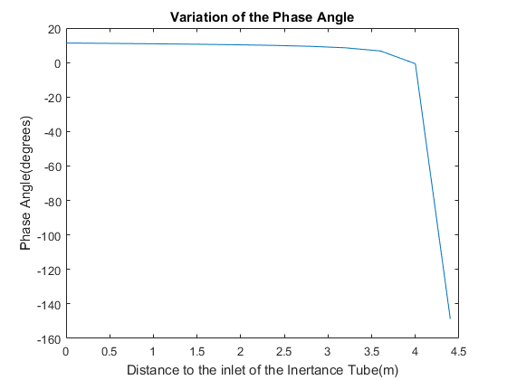
Inertance tube plots(pressure)
Notes:
Isothermal

Slide 15
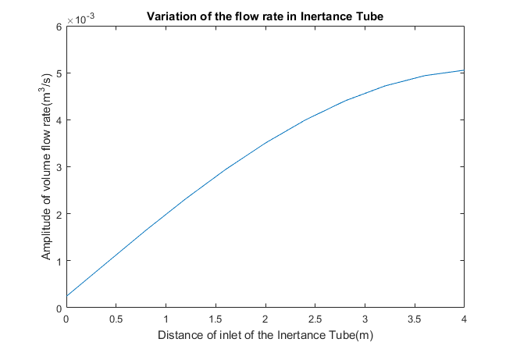
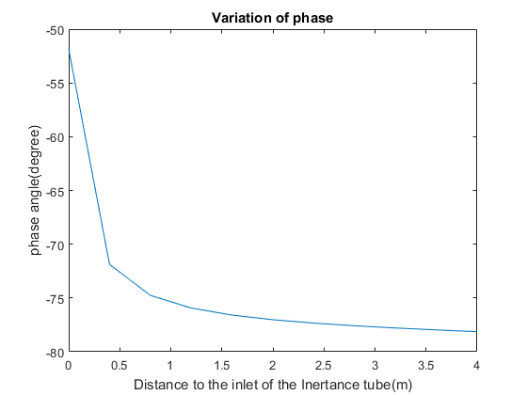
Inertance tube plots(flow rate)

Slide 16

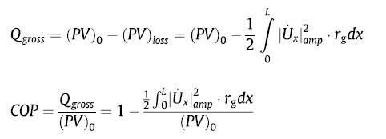
Power loss in regenerator
Power loss happens only due to resistance but not from compliance and inertance.

Slide 17
The gross cooling capacity for a given (PV)₀ at the hot end of the regenerator is high for a higher pressure and lower volume flow rate as the loss is function of square of the volume flow rate.
The volume flow rate decreases across the regenerator due to the void volume.
Reduction in resistance would reduce pressure drop which in turn would increase the drop in volume flow rate, thus decreasing losses.But, decreasing resistance can hardly be done in practice.

Slide 18
Inertance tube (vs) Orifice Tube
Inertance tube is way longer(4.9m vs just a few mm) than Orifice plate. The effects of pressure change take time to propagate over the length of inertance tube. Also experimentally it was observed that inertance tube was better in terms of gross cooling capacity.
When the fluid in the tube is expanded, the fluid in the inertance is still moving right. In this situation, a fluid element in the tube moves less during both the compression and the expansion phase than in the same situation in an orifice pulse tube.

Slide 19
references
1.”An electrical circuit analogy model for analyses and optimizations of the Stirling-type pulse tube cryocooler”, Jun Tan, Haizheng Dang, Cryogenics 71 (2015) 18–29 -MAIN PAPER
2.http://in.mathworks.com/help/symbolic/solve-a-single-differential-equation.html
3.https://in.mathworks.com/help/symbolic/int.html

Slide 20
4.Huang BJ, Chuang MD. System design of orifice pulse-tube refrigerator using linear flow network analysis. Cryogenics 1996;36:889–902.
5.Comparison of the orifice, inertance and double inlet pulse tube refrigerator, S.C.M. Aerts August 1999
6.”Thermoacoustics- A unifying perspective for some engines and Refrigerators”, G.W.Swift

Slide 21
Thanks!
Gowtham Kuntumalla - 140100091
Krishna Sandeep - 140100104
Mohith Sai Nag - 140100107

Slide 22
Work Done till date
We studied the working of a pulse tube cryocooler.
Tried deriving the relation between pressure and volume flow rate from continuity and momentum equations
Looked at proposed electrical models of individual components of the STPC.
Used MATLAB for simulating these electrical analogies and obtained plots close to the actual plots.
Analytically studied the effect of phase between P,V(dot) and relative magnitudes. How PV power is affected.

Slide 23
Code in speaker note below and at the following link.
https://github.com/gowthamkuntumalla/Cryogenics-Electrical-Analogy-of-Pulse-tube-cryocooler
Notes:
%Cryogenics all objects combined
clc;
clear;
%parameters%
f=44;
rho=9.2769;%density kg/m3
phi=.621; %porosity
A=(pi/4)*((15.5)^2)*1e-6;%Cross-section area
S=0.0104;%perimeter of intertance tube cross-section*
mu=13.637e-6;%dynamic viscosity*
nu=1.47e-6;%kinematic viscosity*
delv=sqrt(nu/(pi*f));%viscous penetration depth*
d=mu*S/(A^2*delv);%some constant*
rg=6.87e9; %resistance in regenerator
gam=1.6615;%gamma
pm=33e5;% mean pressure
g=16.73;% Check this value
c=2*pi*f*A/gam/pm;%some constant
a=2*pi*f*rho/(phi*A); %a,b = some combined constants for simplicity
b=2*pi*f*phi*A/(gam*pm);
ro=2.06*10^9;% orifice resistance
%%%%%% Regenerator %%%%%%%
%syms Ur(x) Pr(x)
%Pr(x)= pm-int((a*1i+rg)*Ur(x),x,0,0.079);
%Ur(x)= Ur(0)-int(b*1i*Pr(x)+g*Ur(x),x,0,0.079);
syms u1(x1) p1(x1)
ode1 = diff(p1)+(a*1i+rg)*u1 == 0; % simultaneous differential equations
ode2 = diff(u1)+b*1i*p1+g*u1 == 0; % simultaneous differential equations
odes = [ode1; ode2]; % make a vector
cond1=p1(0)==3.1e5*(cosd(12.5)+1i*sind(12.5));
cond2=u1(0)==0.00042*(cosd(24)+1i*sind(24));
conds=[cond1; cond2];%initial conditions
[psol(x1), usol(x1)] = dsolve(odes,conds); % main solver
x1 = (0:0.005:0.079);
flowvec=subs(usol);
flow = abs(flowvec);
phase = angle(flowvec);
xo = (0:0.005:0.079);
%pressure
p_subs=subs(psol);
p_abs=abs(p_subs);
p_angle=angle(p_subs)*57.1;
%%%%%% Pulse Tube %%%%%%%
%preso=0.65e5*(cosd(-64)+1i*sind(-64));
syms u2(x2)
p2=psol(.079);
u2(x2)=usol(0.079)-c*1i*p2*x2;% p2= pressure in pulse tube(constant along length), u2 = volume flow rate
x2 = (0:0.005:0.1);
usol2=subs(u2);
psol2=subs(p2);
%%%%%% Orifice %%%%%%%
p3 =p2-ro*u2(0.1);
%%%%%% Inertance Tube %%%%%
syms p1i(xi) ui(xi)
ode1i = diff(p1i)+(a*phi*1i+d)*ui == 0; % simultaneous differential equations
ode2i = diff(ui)+c*1i*p1i == 0; % simultaneous differential equations
odesi = [ode1i; ode2i]; % make a vector
cond1i=p1i(0)==p2;
cond2i=ui(0)==u2(0.1);
condsi=[cond1i; cond2i];%initial conditions
[psoli(xi), usoli(xi)] = dsolve(odesi,condsi); % main solver
xi = (0:0.4:4.37);
flowveci=subs(usoli);
%flowi = abs(flowveci);
%phasei = angle(flowveci);
%%%%%% Reservoir %%%%%%%
syms u4(x4)
u4=u2(.1)-c*1i*p3*x4;

